Slide 1
Climate Change Model Step-by-Step
Cliff Gold

Slide 2
Agenda
Introduction
The Data
The Knobs
Building the Model
Try It Out

Slide 3
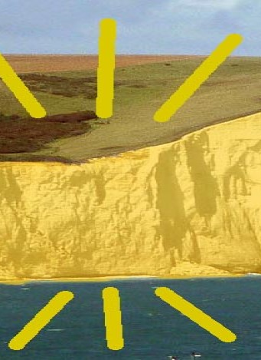
Introduction
I’m Cliff Gold, a retired chip designer.
In chip design, a single mistake – a single gate in a design with billions of gates – can cost millions of dollars and months of delay.
At a gigahertz, a mistake with a one in a billion chance happens once a second.
I’ve learned to become appreciative of those finding bugs in my design.
I’m also ridiculously picky.

Slide 4
The Data
The EIA (Energy Information Administration) has hourly energy supply data which gets updated every day.
Used the 4 years from 2020 – 2023 inclusive. That’s 35,064 points, for each Solar, Wind, Nuclear, Gas, Other. For each of 13 regions. 2,279,160 Data Points
Other information like cost, lifetime, etc. also from EIA where possible
Links to the source data are provided in the spreadsheets.
Note that this is the Supply. We assume that Demand = Supply, i.e. no outages.
Similarly, “capacity” refers to the max supply at any hour.

Slide 5
The Data – California, Starting 1/1/2020
Date | Solar | Nuclear | Wind | Coal | Hydro | Gas | Other | Oil
20200101T00 | 1874 | 2273 | 242 | 694 | 401 | 9123 | 714 | 91
20200101T01 | 10 | 2272 | 227 | 1000 | 608 | 11414 | 717 | 91
20200101T02 | -25 | 2273 | 263 | 1148 | 1076 | 11254 | 715 | 91
20200101T03 | -24 | 2272 | 379 | 1086 | 1086 | 10441 | 723 | 91
20200101T04 | -26 | 2272 | 351 | 965 | 876 | 10151 | 726 | 46
20200101T05 | -26 | 2272 | 278 | 968 | 538 | 9988 | 732 | 90
20200101T06 | -26 | 2275 | 249 | 971 | 511 | 9910 | 745 | 90
20200101T07 | -26 | 2275 | 334 | 982 | 429 | 10313 | 745 | 46
20200101T08 | -25 | 2275 | 289 | 978 | 397 | 10294 | 747 | 46
20200101T09 | -26 | 2272 | 334 | 771 | 304 | 10236 | 750 | 91
20200101T10 | -27 | 2274 | 654 | 665 | 259 | 9321 | 749 | 90

Slide 6
The Knobs
For each run, we vary various parameters
The key one is the price on CO2 – how much incentive does it take for each improvement
Demand is another key one – how much does total demand go up each year. This may have to be revisited due to AI.
Interest rate for loans is another important general one. If the government supplies low-cost loans, nuclear(especially) becomes cheaper.
For each energy source, we can vary:
Capital, Fixed, and Variable Cost
Lifetime
Max Growth Rate

Slide 7
Model Flow 1
Last Year
Demand
Optimizer Chosen Multiplier
This Year Supply
Figure total cost
Solar Hourly
X
Solar Hourly
Cost
Figure Next
Test
Wind Hourly
X
Wind Hourly
Cost
Nuclear Hourly
X
Nuclear Hourly
Cost
Gas
Hourly
X
Gas
Hourly
Cost
Sum
Demand Multiplier
Sum
Hourly Demand
X
Hourly Demand
Outage?

Slide 8
Model Flow 2
Do Next Year
Past
Hourly Supply
Per NRG
End Of Life
Base Hourly
Supply
Add Capacity (Test)
No
No
Best?
Yes
27 Years?
Total Hourly Supply
Demand increase
Calculate Cost
(CO2 Price, Fixed, Variable, Outage)
Yes
NRG/ CO2 Prices, Etc
Case Mods
Put in Library

Slide 9
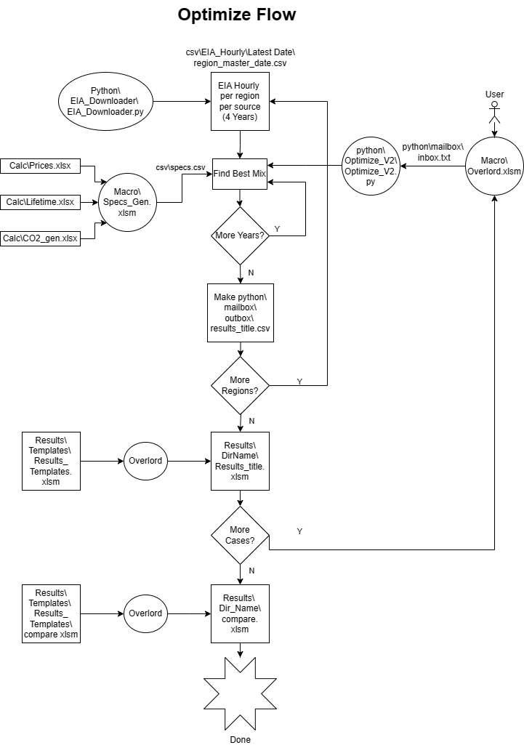
Detailed Block Diagram
This is the detailed block diagram
It shows all the steps, and the names of associated files
Do you want to get into it now?

Slide 10
Building the Model: Library
Standard format for paths
Run separately for each of 13 regions. If possible, run in parallel on different cores in the processor.
One “Case”, with 10 CO2’s, 13 regions takes about 1 Hr 40 min
It goes through hourly loop about 25 billion times

Slide 11
Building the Model: Excel
Command | Initial | Per Year
Clear
Kill_Mail
Region | US
Years | 27
Directory | Demand
SubDir | 1%
Demand | 1.01 | 1
Run_All
SubDir | 3%
Demand | 1.03 | 1
Run_All
On the right, is a typical program to generate a library directory. The program Lib_Gen.xlsm in subdirectory Macro is used.
It runs 10 CO2 cases with 1% per year demand factor, then 10 more with 3% demand. There are 5 cases with constant CO2, and 5 cases with increasing CO2
Region = US says run all 13 cases. CAL, MIDA, etc. will run only one region
I expect that I am the only one to actually run this. Send me an email if you want me to run some cases. If you want to exceed my expectations and try running it, let me know.

Slide 12
Comparison:
Running macro/lib_compare.xlsm allows cases in the library to be compared
Plan is to build a library
Working on easy sharing of this one. Someone familiar with Excel should be able to run it.
Let’s try it out!
Deep Dive
Everything is in github.com/cliffgold/optimize

Slide 13
Special Thanks To
Aarav Garg for getting it to run on Mac
Joseph Sauer for Excel suggestions
Lucas for working with EIA to get storage numbers right.
Rory Edelson for setting up the EIA download program, my first real Python experience.
The EIA
Eric Meyer for inspiration
All the others who helped with discussion, advice, and vision

Slide 14
Thank You

